Slide 1

5LC
Lite Logical Logistics LLC
The Smart Light Switch
Notes:
Red: #e94e4e
Beige: #f7f1d7

Slide 2



Project Brief
To reduce waste through usage of an Arduino incorporating IOT concepts in Phoenix, AZ, United States and Belfast, Northern Ireland

Slide 3
Project Statement
Arizona State University and Queen’s University Belfast’s Carbon Management Plans list lighting and electrical usage as approximately 35% of emissions.
This energy is not utilized to full potential and creates a significant carbon footprint.

Slide 4
Introducing
5LC
A system that:
Simplifies a simple daily task by allowing residents and corporation members to move between rooms without manually turning off lighting
Better targets emergency efforts by indicating which rooms may have people inside to ensure that time and effort is not wasted during emergency situations.
Mission Statement:
To reduce electrical waste through adaptive light switches that will illuminate the room and count the number of occupants in a given area

Slide 5
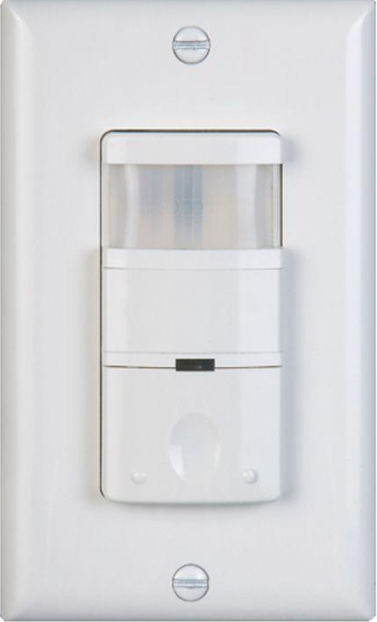
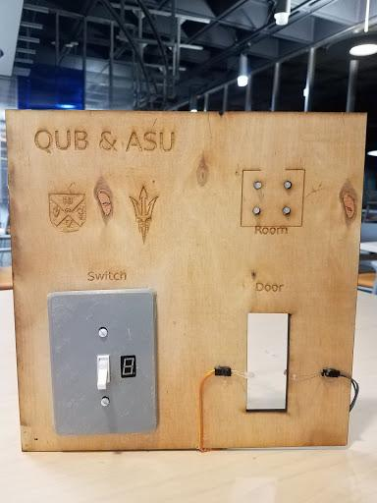
Motion Detection Light Switch
Presence Detection Light Switch
Pros:
Turns on automatically when motion is sensed
Quick installation
Cons:
Automatically turns off after a given period of stillness
Requires extra movement waste to always keep on
Pros:
Includes occupancy tracking
Dual purpose as a security device
Can be networked together
Can use different detection technologies including RFID and Ultrasonic movement detection
Future improvements:
A detection system of how many people are in a room when initially booted up

Slide 6



Features
Usability:
Easy to Operateー Reduces power wastage with a simple microcontroller and the standard light switch system
Safe from tampering ー While the system works on the whole room, by concealing it within a light switch, we stop potential tampering of the system.
Security ー Has a dual use as a safety device for emergency situations
Hassle-Free Implementation:
Compact ー Small size for easy integration into society.
Cost ー Cost-effective solution that can work from residential to commercial use cases through inexpensive technology, production, and maintenance
Modularity:
Universal Solution ー This power conservation solution can be connected to different systems to provide output such as Heating, Ventilation, Air Conditioning, Security and Room Booking systems.
Expandability ー Through the use of IoT and Communication technologies, the proposed solution could be expanded on a stand-alone installation to across a University campus.

Slide 7
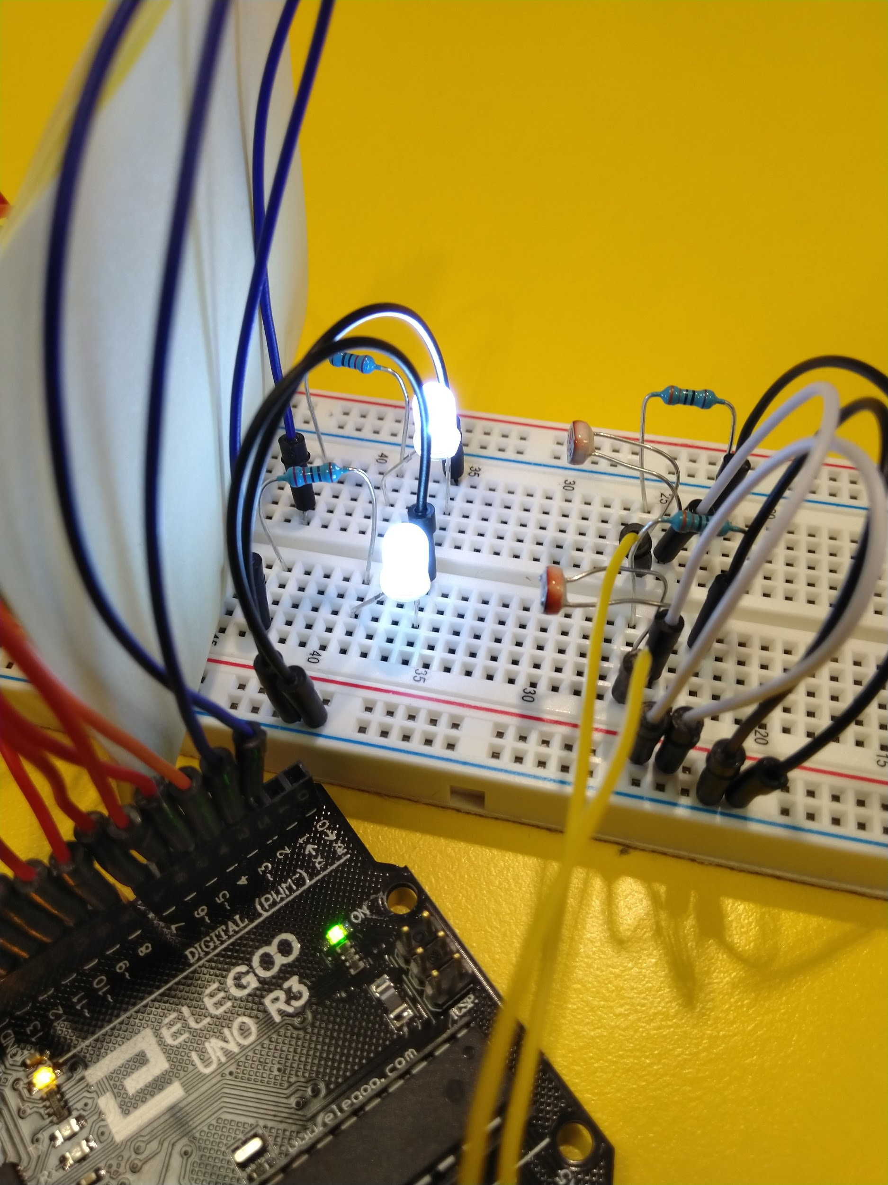
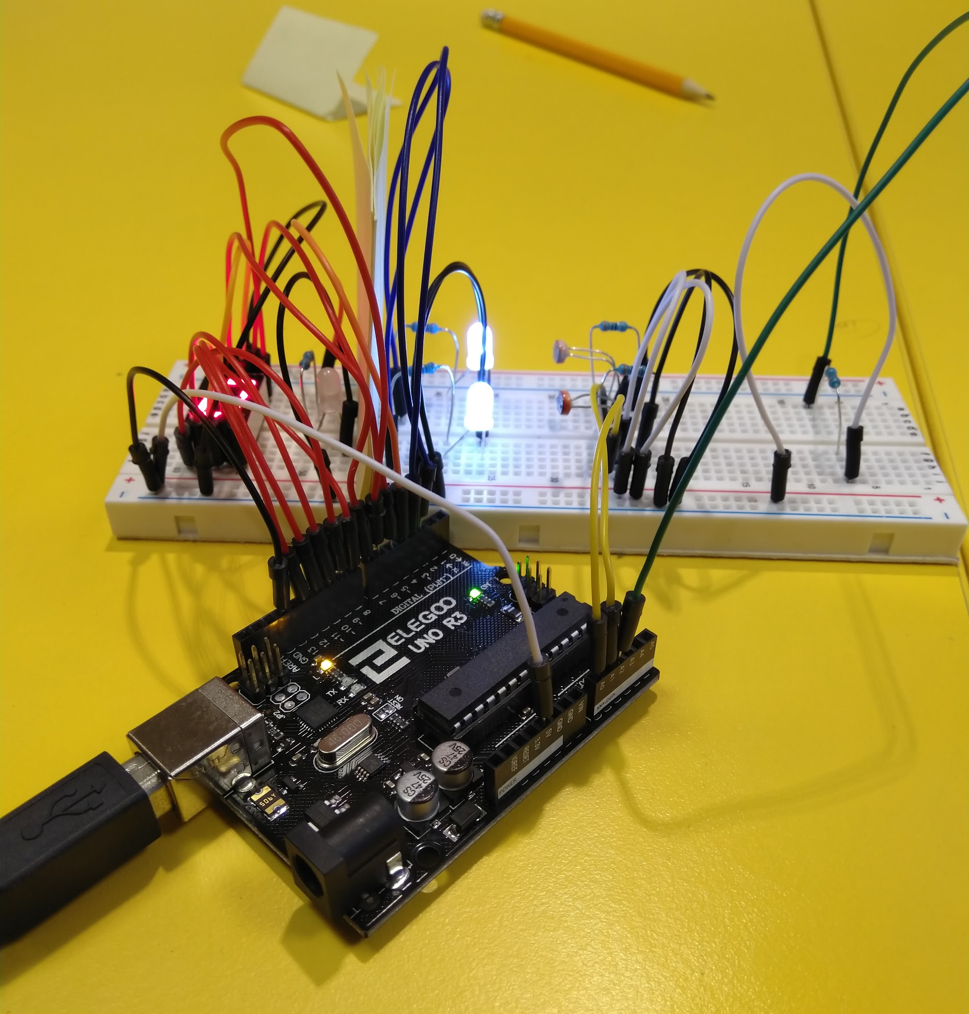
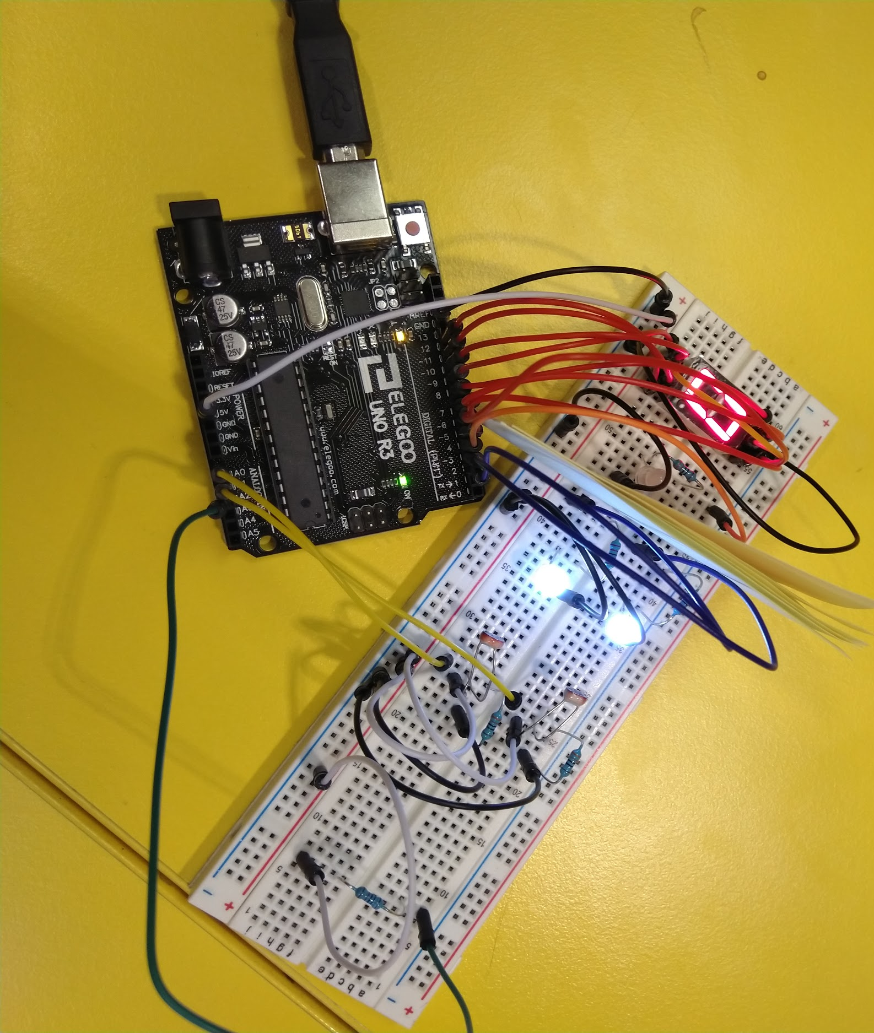
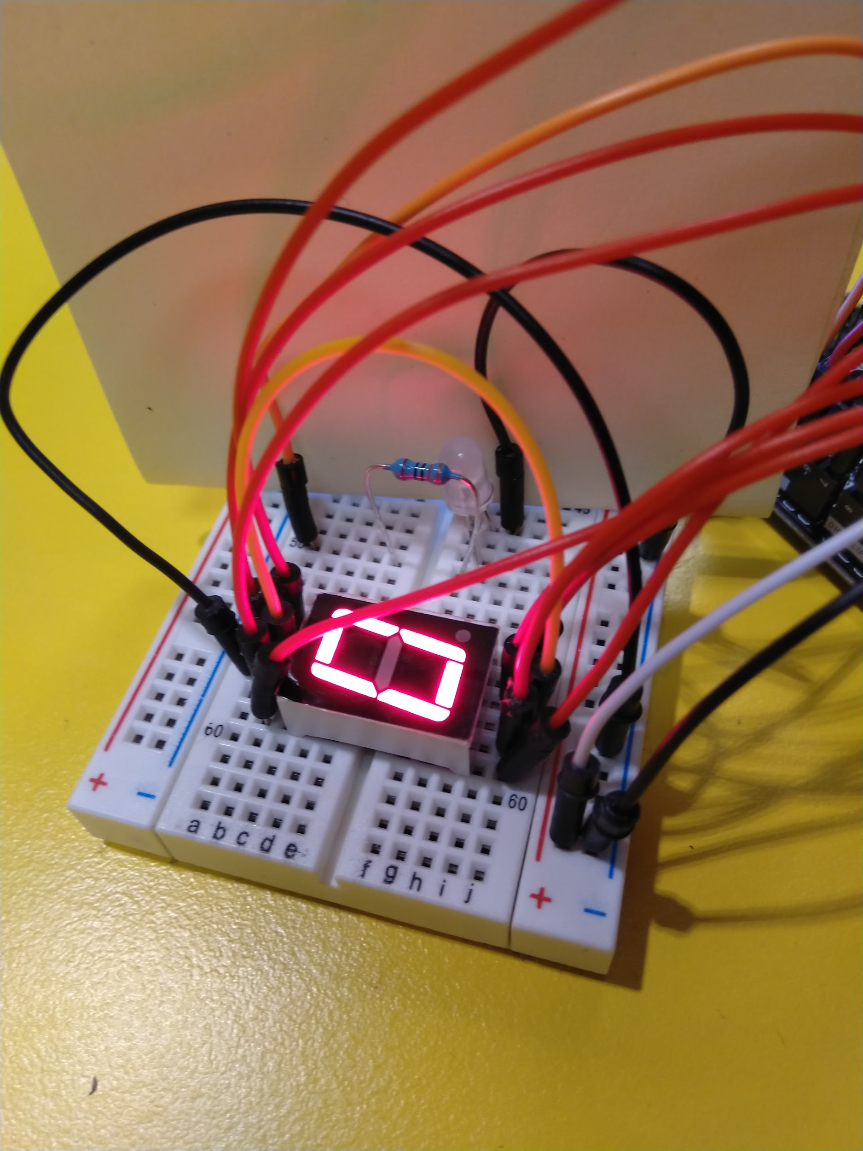
Preliminary Prototype

Slide 8
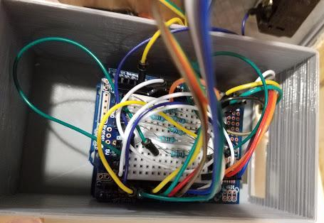
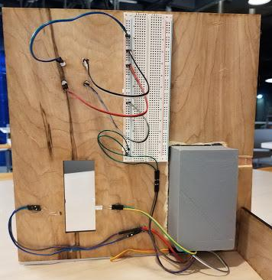
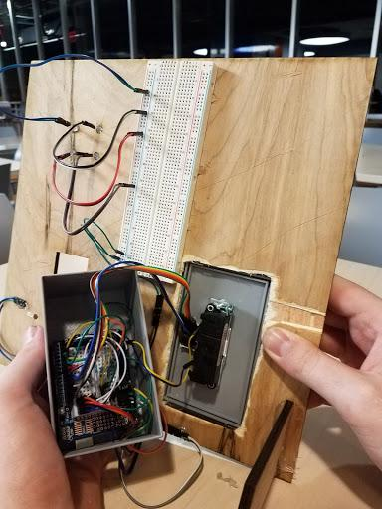
Final Prototype

Slide 9


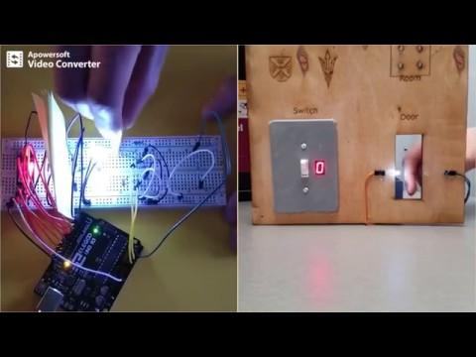
Demonstration

Slide 10
Benefits to society
Reduced electricity grid usage | Through stopping the waste of electricity in an area where it is not needed, we reduce the strain on the electricity grid. Through doing so, the bill for electric in a deployment will be reduced
Reduced carbon levels emitted | By reducing the amount of electricity wasted, it means we burn less fossil fuel on energy that wouldn’t have been used efficiently
Cleaner air | Through reducing fossil fuel burnage, we promote a cleaner air environment which will have a global benefit
Automation within buildings | The modularity and IoT communication used in our proposed solution would allow the data sent by each Arduino to be operated upon by a master server and could provide input into other systems, such as an Automated room booking system with power control and notifications to the organiser if the room is not used during the booking, Over-The-Air room interactions through the internet or possibly an app or even Security monitoring from a central location

Slide 11

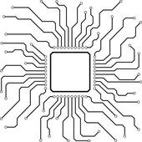
Future Scope
Future Goals
Due to time and resource restriction we could not use additional technologies such as RFID technology, machine learning, and integration into existing systems such as a room booking system.
Additional features:
Smart thermostat
Automatic opening of blinds or windows
Motion detectors for partial lighting in a room
Produce an ASIC printed circuit board with the specific functions hard coded into it so that the processing and the large physical footprint of a full arduino circuit is minimized and the board is more easily mass produced.

Slide 12

Team
Patrick McGurnaghan
Robert Hawkes
Peter Cornacchio
Kevin McNamara
Jessica Westerham

